Slide 1

Comprehensive Design and Analysis Project
IT4010 | 2021
Enhancing
Online Teaching & Learning Experience
by Using
Multiuser Virtual Environment
2021-065

Slide 2




Our Team
Supervisor | Dr. Nuwan Kodagoda
Co-supervisor | Ms. Kushnara Suriyawansa
IT18006544
IT18001112
IT18009132
IT18007848
Perera H.D.D.S
Tharaka W.C.M.K.
Dilanka R.M.T.
Rathnayake R.H.C.S.

Slide 3

IT18006544
Perera H.D.D.S.
B.Sc. (Hons) Degree in Information Technology Specialization in Software Engineering

Slide 4

Introduction to Overall project
IT18006544
Effect of Covid-19 in education sector
Perera H.D.D.S
Since video conferencing tools are not intended for teaching and learning purposes, overall learning and teaching experience has become less productive
Shared questionnaire among undergraduate
01

Slide 5

Research Question
IT18006544
How to enhance online learning and teaching experience ?
Perera H.D.D.S
02

Slide 6
Objectives
Main Objective
IT18006544
Perera H.D.D.S
Enhancing Online Teaching and Learning Experience.
Sub Objective 1
Analyzing the students’ attentiveness to the lecture and help them to keep their attention.
Sub Objective 2
Reducing students' isolation during online lectures and enabling the collaborative learning using multiuser virtual learning environment.
Sub Objective 3
Providing a near-real time, simulated student behavioural view of the students.
Sub Objective 4
03
Help students by providing well-organized and summarized lecture note using optimized lecture transcription

Slide 7
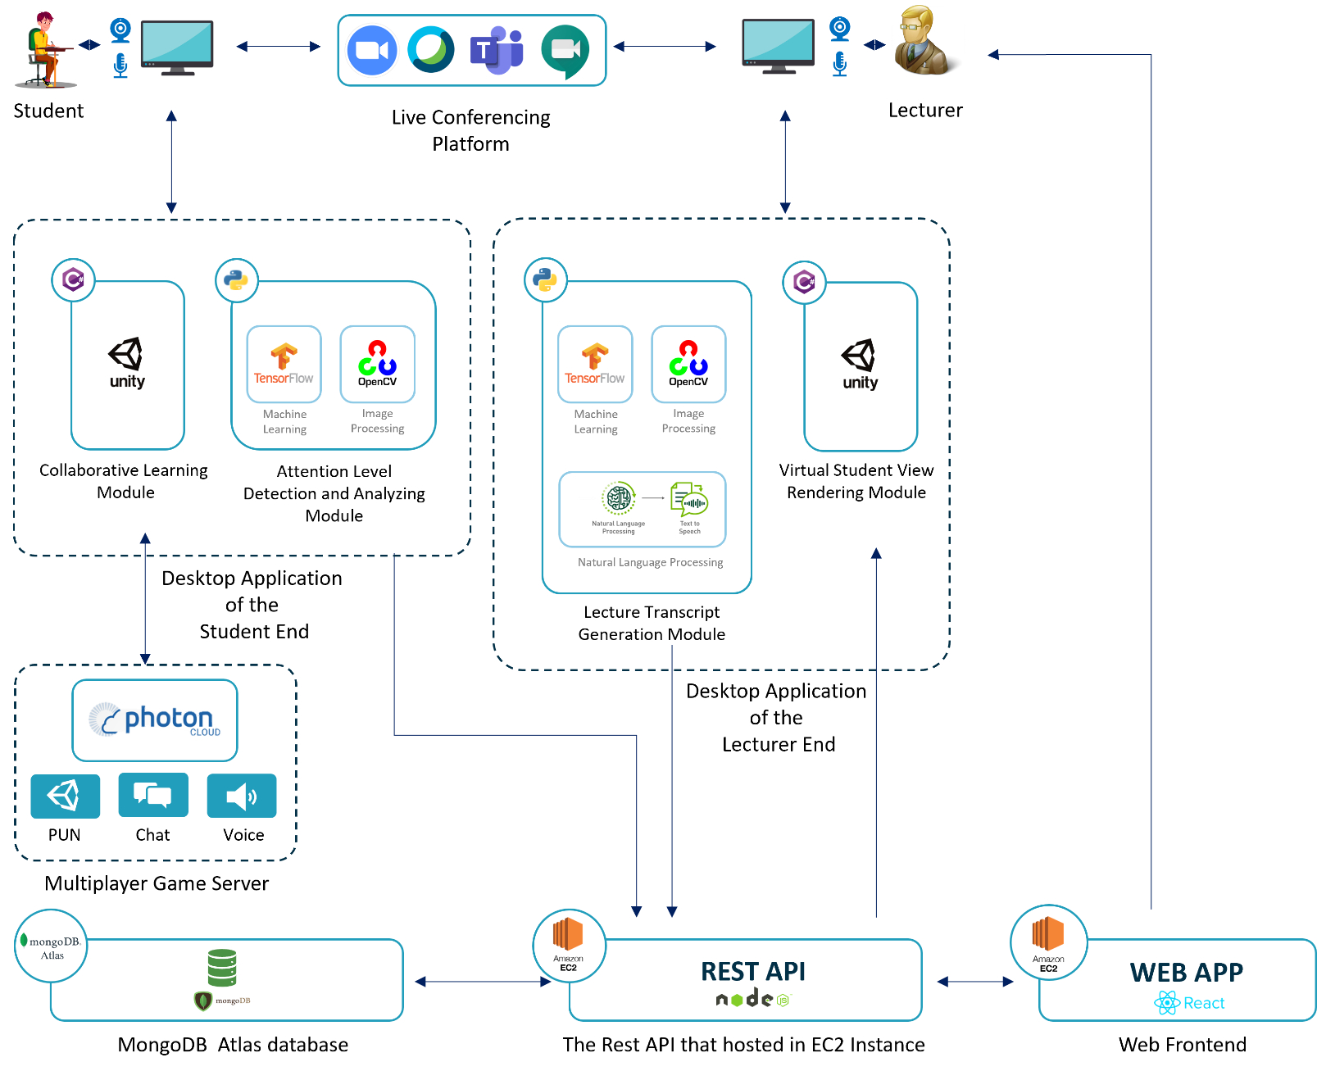
Overall System Diagram
IT18006544
Perera H.D.D.S
04

Slide 8
SUB OBJECTIVE - 01
Analyzing the students’ attentiveness to the lecture and help them to keep their attention

Slide 9

Research Question
How to capture student attention level during Online lectures ?
IT18006544
Perera H.D.D.S
How to improve student attention level during online lectures ?
05

Slide 10
Objectives achieved
Use of deep learning models to train and capture student’s facial emotion
IT18006544
Perera H.D.D.S
Functional dashboard to provide information regarding class and individual
student
Use of edge computing technique to analyze the captured emotions
Optimized algorithm to provide feedback to students periodically.
06

Slide 11
System, Software and Personnel Requirements
System Functional Requirements of the Project
IT18006544
Perera H.D.D.S
Capturing and analyzing student’s attention through facial emotions.
Suggesting methods for lecturer to increase student attentiveness
Periodically notifying student about their attentiveness
Allowing lecturer to view overall and individual student attentiveness
System Non-Functional Requirements
Security
Performance
07

Slide 12

Risks and solutions
Student privacy
IT18006544
Perera H.D.D.S
Use of edge computing architecture
Capturing and processing facial emotions in client side.
Sending only the processed information to the server side.
Need of stable connection
Data bandwidth usage
08

Slide 13
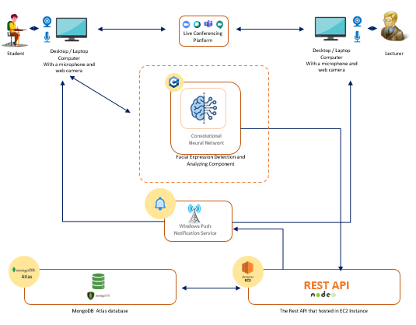
System Architecture
System Architecture Diagram
Technologies Used
IT18006544
Perera H.D.D.S
Python
Node JS / Express JS
AWS EC2 Instance
Google Collab
Window Push Notification Service
Convolutional Neural Network
09

Slide 14
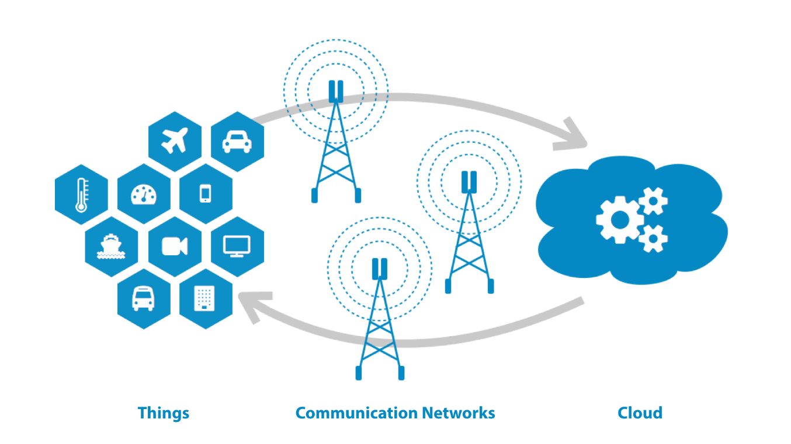
System Architecture
Why edge computing architecture over Cloud Computing ?
IT18006544
Perera H.D.D.S
Privacy and Security
Reduce bandwidth
Reduce server workload
10

Slide 15
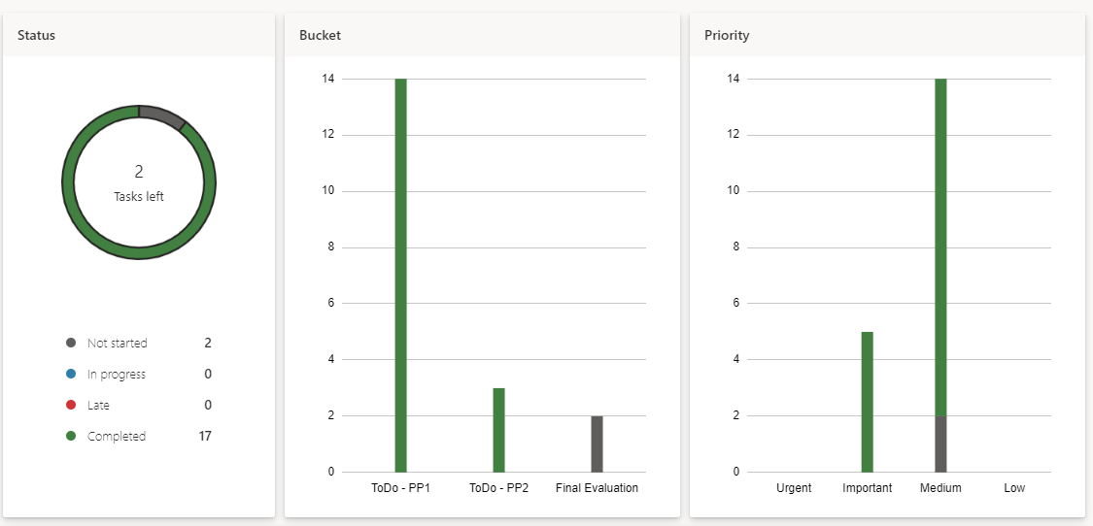
Progress up to Progress Presentation - 02
IT18006544
Perera H.D.D.S
11

Slide 16
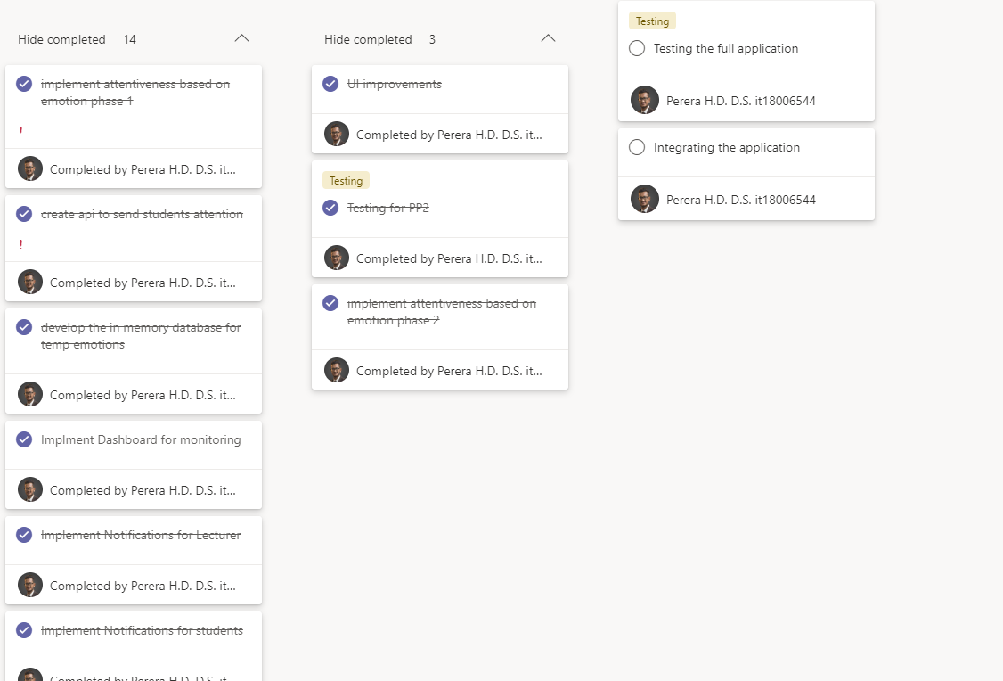
Progress up to Progress Presentation – 02
IT18006544
Perera H.D.D.S
12

Slide 17
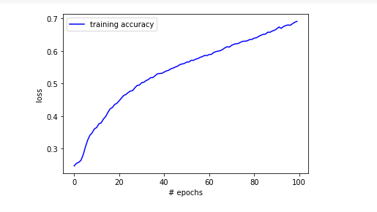
Progress up to Progress Presentation – 02
IT18006544
Perera H.D.D.S
Accuracy improved from 51% ➔ 70%
Model trained for 29000 data images
Tested with 5000 test data
13

Slide 18
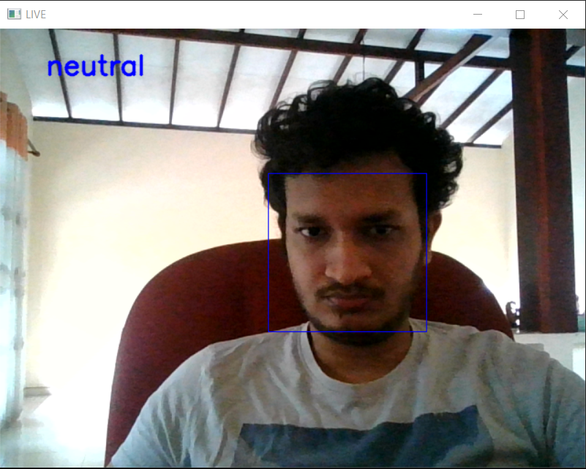
Progress up to Progress Presentation – 02
IT18006544
Perera H.D.D.S
Emotion capturing instance
This will be running as a background
process
14

Slide 19
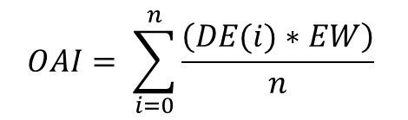
Progress up to Progress Presentation – 02
Equation to calculate the Attention Index and Overall Attention Index
IT18006544
Perera H.D.D.S
$AI=DE∗EW$
Dominant Emotion | Emotion Weight
Neutral | 0.9
Happy | 0.6
Surprised | 0.3
Fear | 0.4
Disgust | 0.25
Sad | 0.2
Anger | 0.2
$$OAI= \sum_{i=0}^{n}{\frac{\left(DE(i)∗EW\right)}{n}}$$
Where :
AI = Attention Index
DE = Dominant Emotion
EW = Emotion Weight
OAI = Overall Attention Index
n = Number of iterations
15

Slide 20
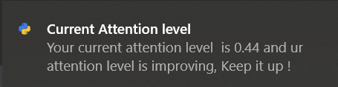
Progress up to Progress Presentation – 02
Student Notifications
IT18006544
Perera H.D.D.S
16

Slide 21
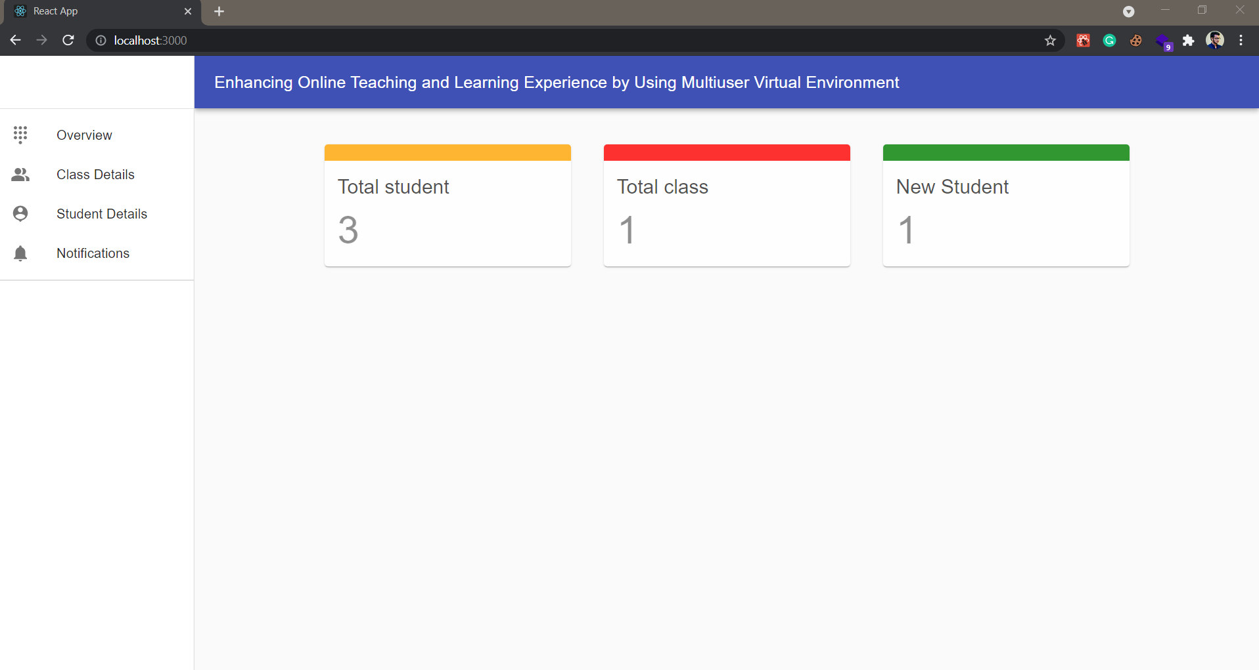
Progress up to Progress Presentation – 02
IT18006544
Perera H.D.D.S
17

Slide 22
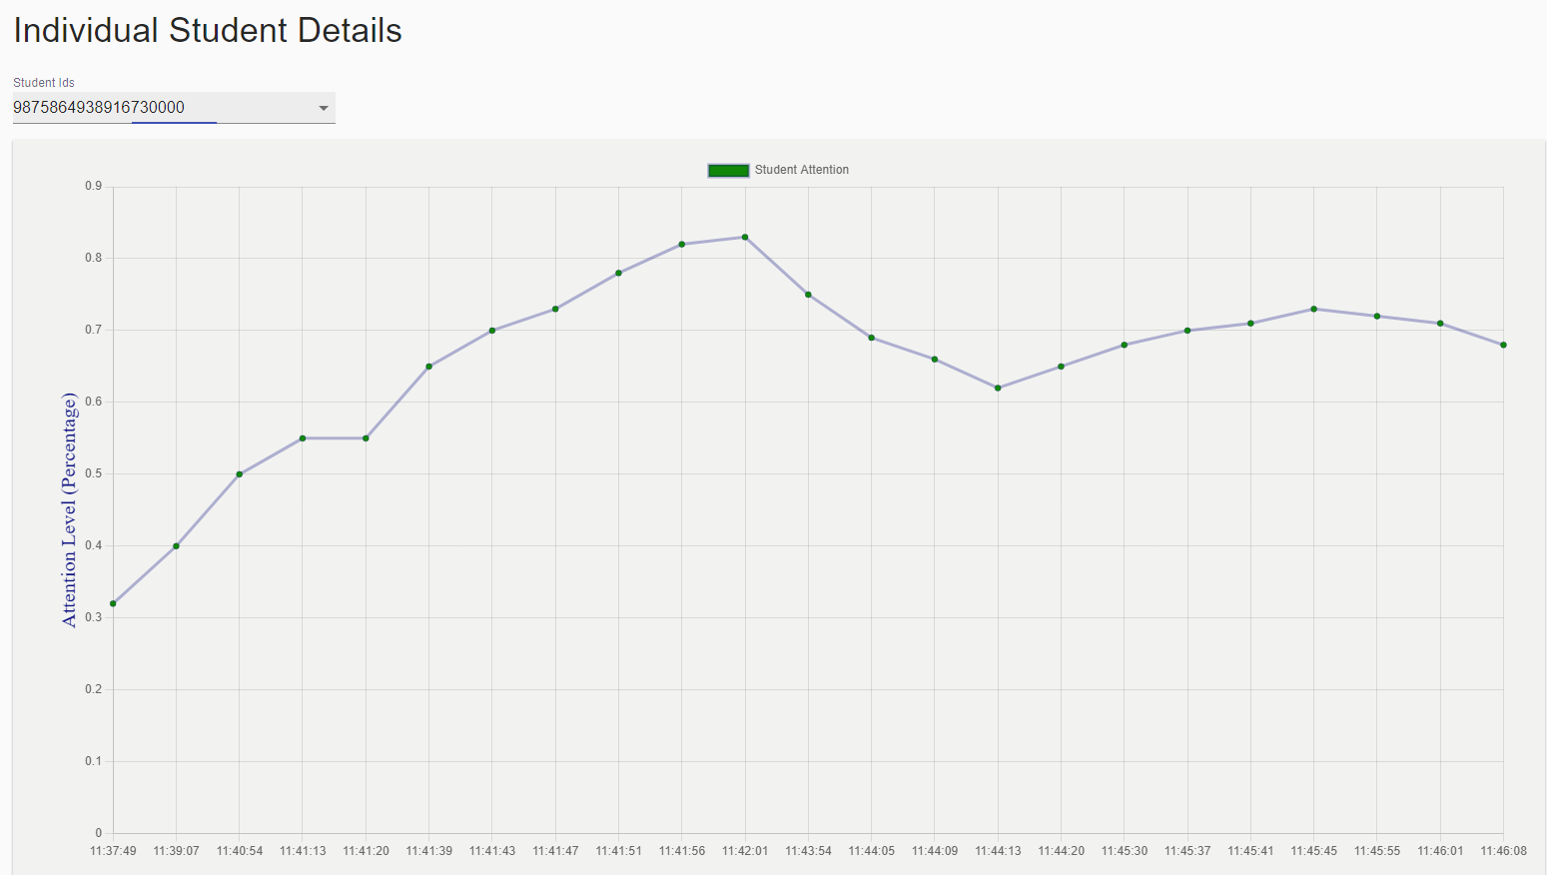
Progress up to Progress Presentation – 02
Individual Student Attention Graph
IT18006544
Perera H.D.D.S
18

Slide 23
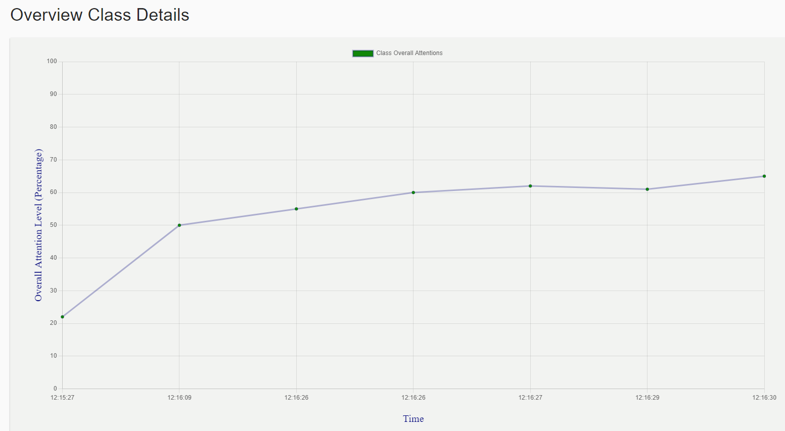
Progress up to Progress Presentation – 02
Overall Class Attention graph
IT18006544
Perera H.D.D.S
19

Slide 24
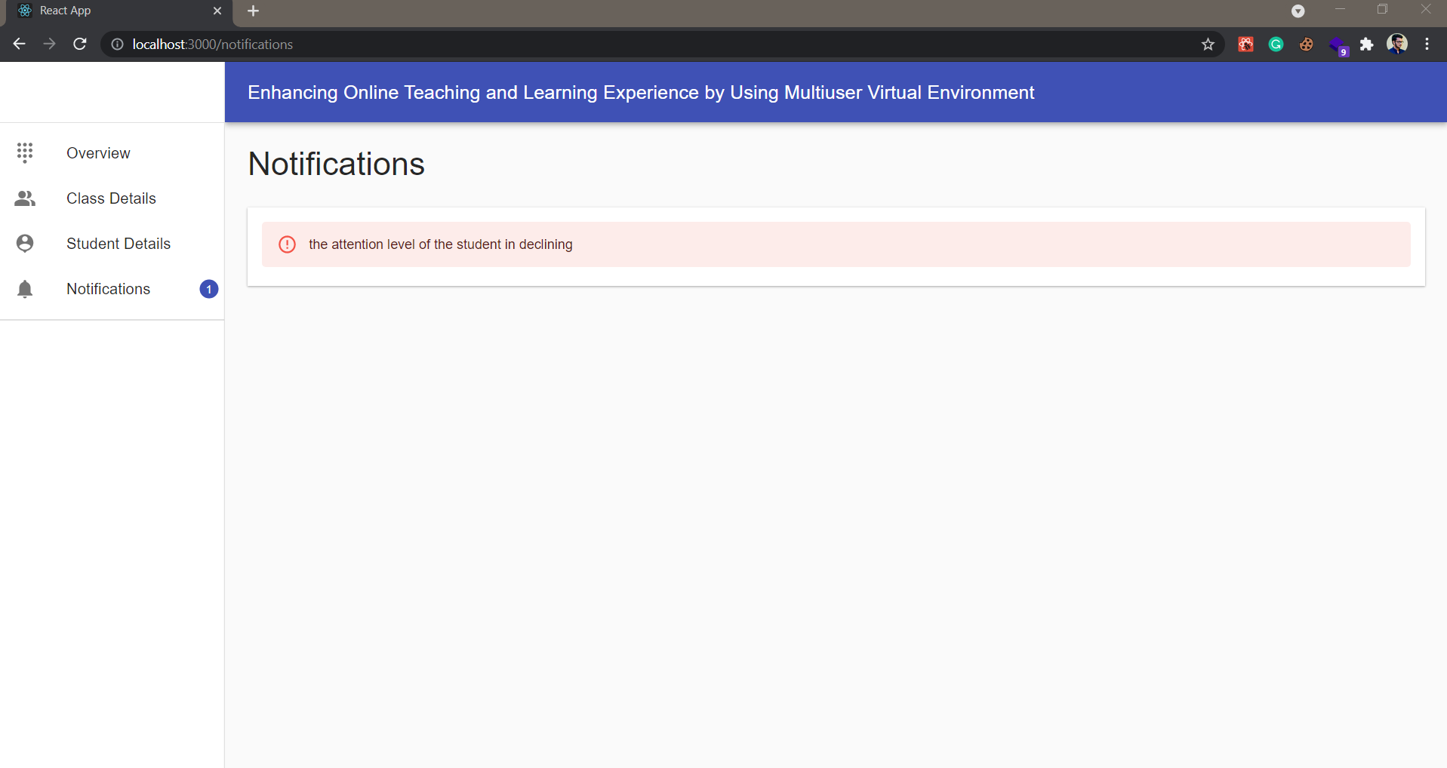
Progress up to Progress Presentation – 02
IT18006544
Perera H.D.D.S
20

Slide 25
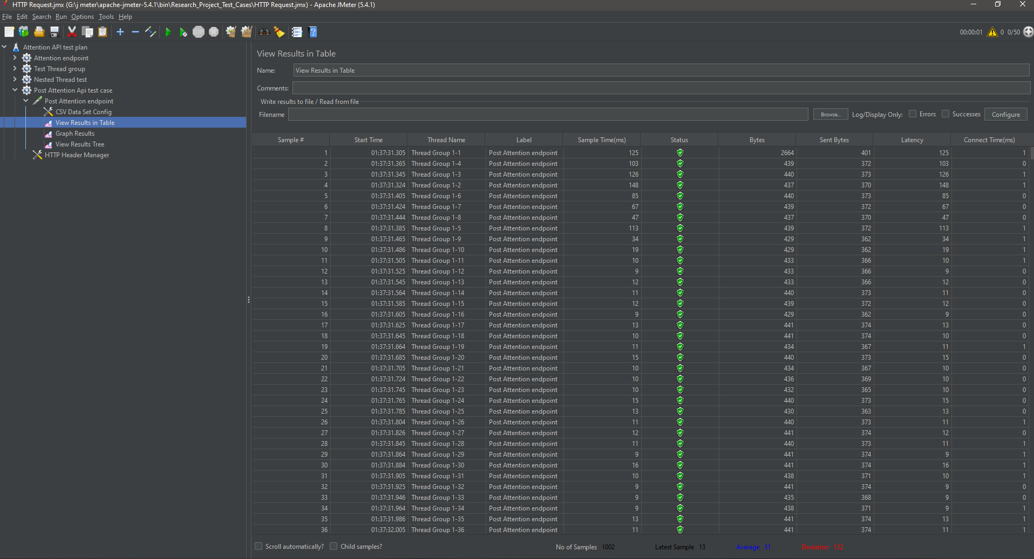
Progress up to Progress Presentation – 02
IT18006544
Perera H.D.D.S
Load Testing – Tested
21

Slide 26
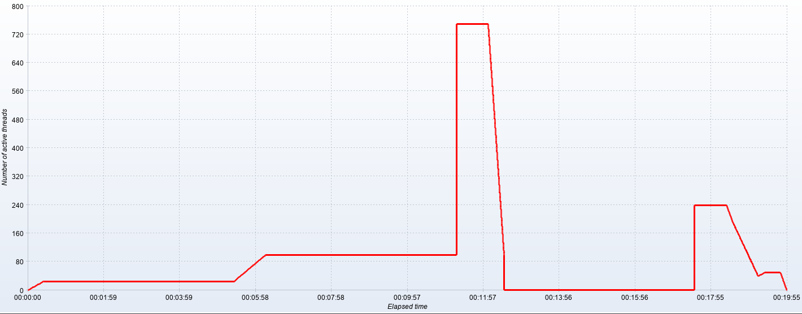
Progress up to Progress Presentation – 02
IT18006544
Perera H.D.D.S
Spike Testing– Tested
22

Slide 27
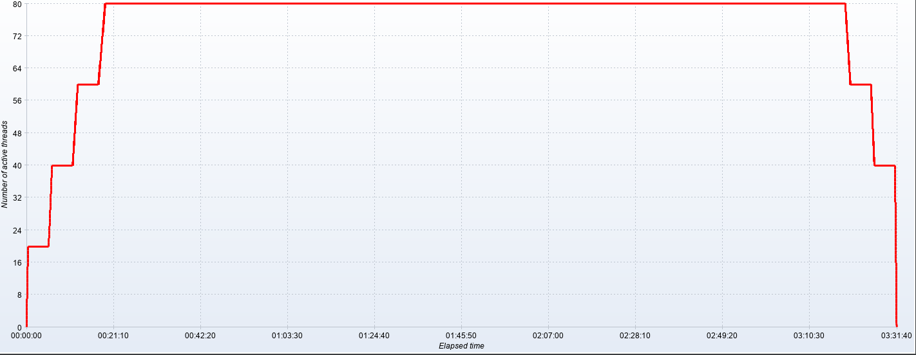
Progress up to Progress Presentation – 02
IT18006544
Perera H.D.D.S
Endurance Testing – Tested
23

Slide 28
IT18006544
Perera H.D.D.S
Demonstrations
24

Slide 29
IT18001112
Tharaka W.C.M.K.
B.Sc. (Hons) Degree in Information Technology Specialization in Software Engineering

Slide 30
SUB OBJECTIVE - 02
Reducing students' isolation during online lectures and enabling the collaborative learning using multiuser virtual learning environment

Slide 31


Introduction
Previous situation: Students were studying together
IT18001112
Tharaka
W.C.M.K.
Present situation: Students are studying remotely
Collaborative learning
4 C’s of 21st Century Learning Skills [1]
Participation Metaphor [2]
Benefits of Collaborative learning [3]
25

Slide 32
Research Question
IT18001112
How to enable the Collaborative Learning in an efficient manner
while students are not in same place?
Tharaka
W.C.M.K.
How to reduce student isolation during online lectures?
26

Slide 33

Objectives
Enabling collaborative learning [1], [4]
IT18001112
Tharaka
W.C.M.K.
Build a Virtual Learning Environment to Increase the Immersiveness [5]
Build character models for students
Implement collaborative content editing (Brainstorming, Text Editing)
Reducing student isolation during online lectures
Implement Voice communication channel
between a few numbers of friends
27

Slide 34
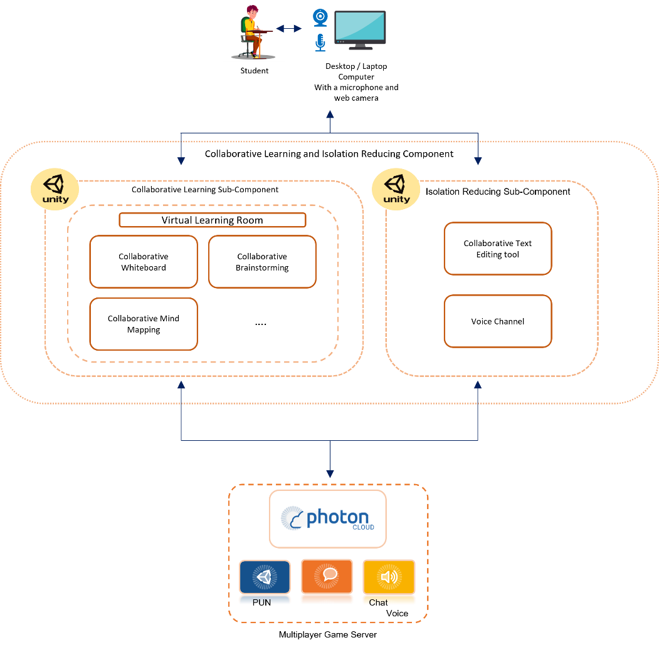
Overview Diagram and Technologies Used
IT18001112
Tharaka
W.C.M.K.
Unity Game Engine - Build the Virtual Environment
C# - Development language of Unity
Visual Studio IDE
Photon Unity Networking - Multiuser Development in Unity
Photon Voice - Multiuser Voice Communication
Photon Chat - Multiuser Message Communication
28

Slide 35

Functional & Non- Functional Requirements
Completed Requirements
IT18001112
Tharaka
W.C.M.K.
Redesign the Virtual Room Environment to a more natural view
Character 3D Models
Character Movements and Animation Synchronization
Multiuser Access to the Environment
Multiuser Voice & Text Communication
Collaborative Brainstorming Tool
29

Slide 36
Functional & Non- Functional Requirements Contd.
Remaining Requirements
IT18001112
Tharaka
W.C.M.K.
Finetune Collaborative text editing in the Virtual Learning Environment
Testing the component
Non-Functional Requirements of the Component
Availability – Photon Cloud
Reusability - Reusable Prefabs, Materials, Textures…
Modifiability - Best practices in Unity Engine and Game development
30

Slide 37
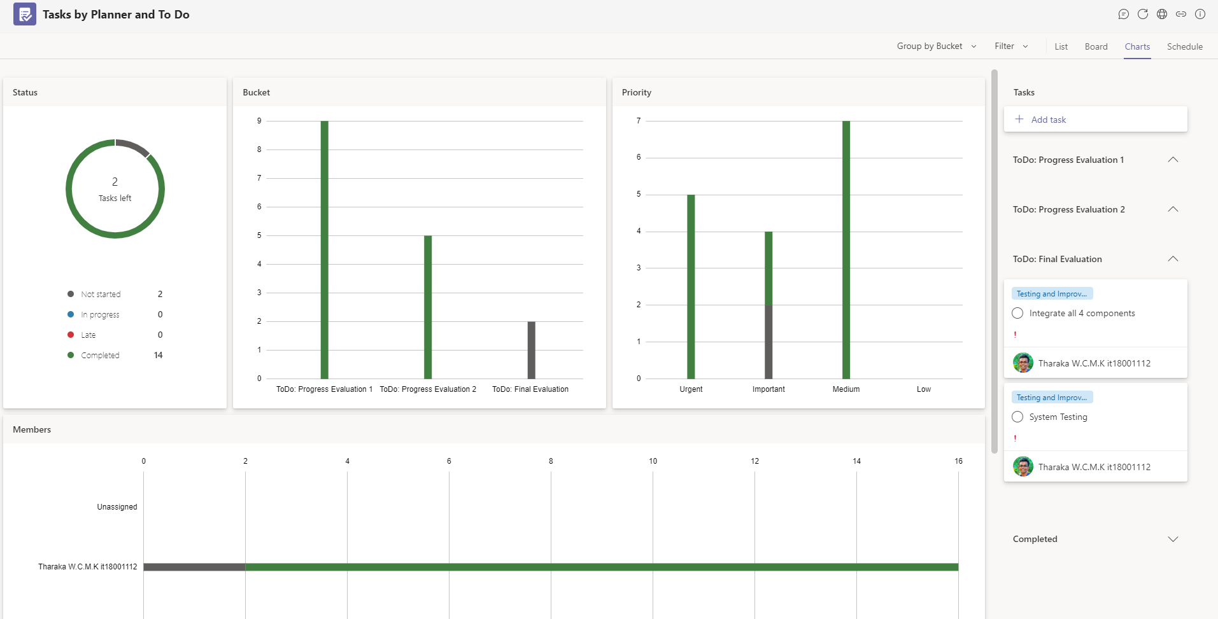
Progress up to Progress Presentation-02
IT18001112
Tharaka
W.C.M.K.
31

Slide 38
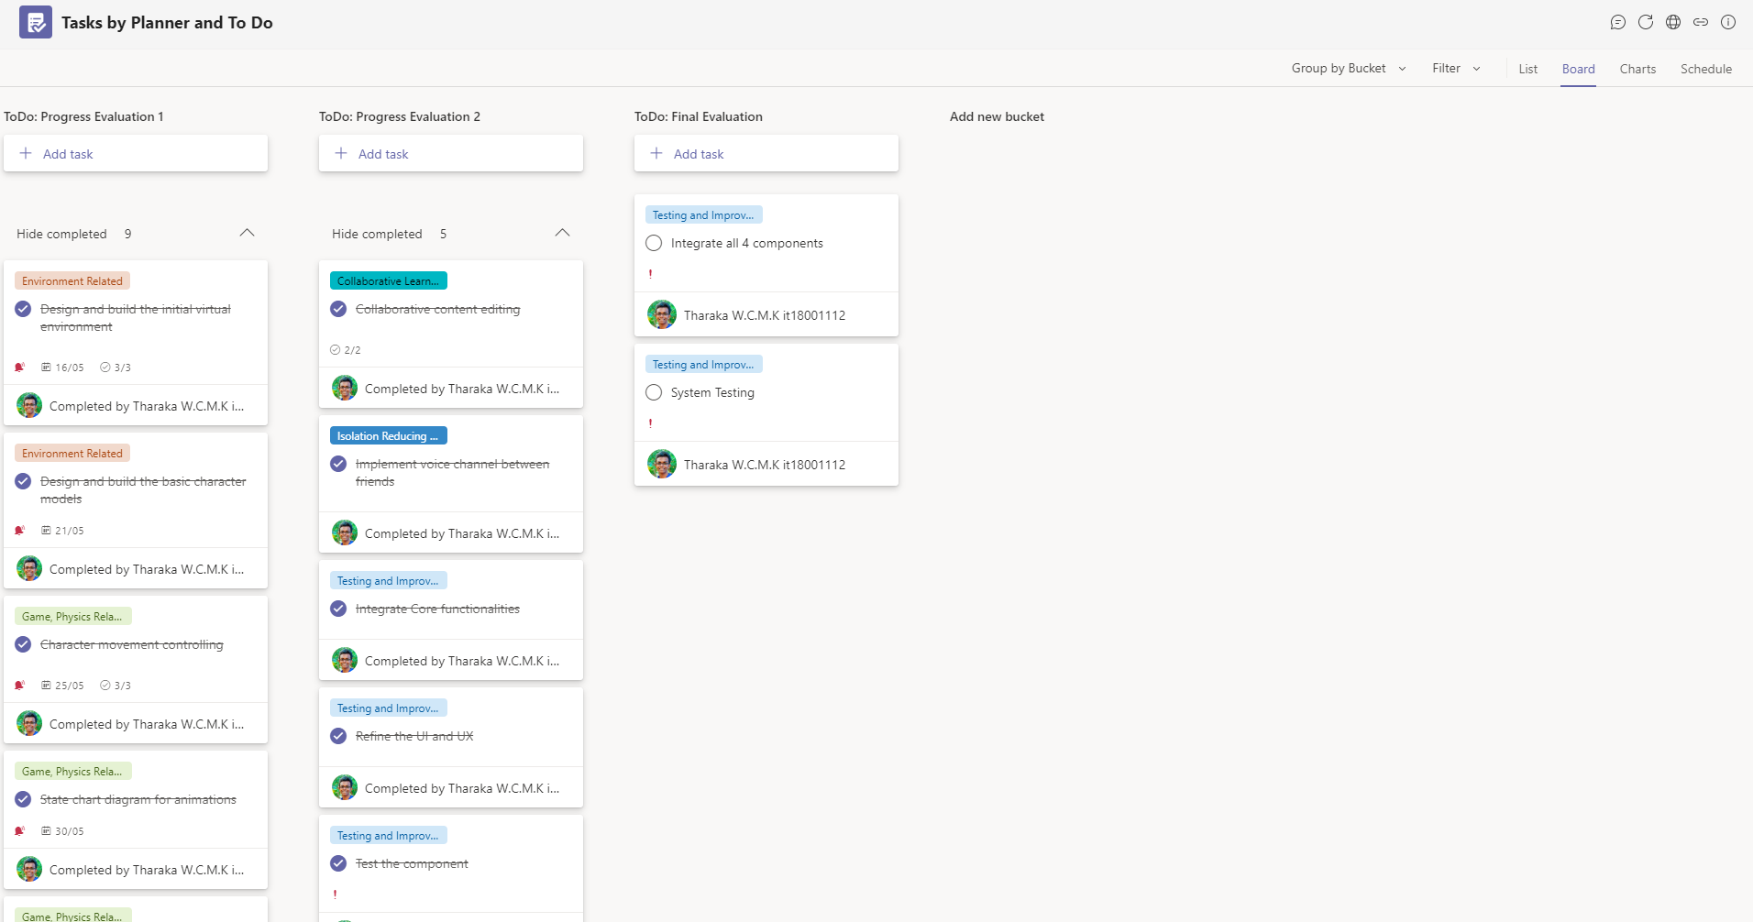
Progress up to Progress Presentation-02 Contd.
IT18001112
Tharaka
W.C.M.K.
32

Slide 39
Raised Problems and Risks
Data consumption in animation synchronization – Addressed
IT18001112
Tharaka
W.C.M.K.
Repeated sound in voice communication – Addressed
Text chat communication - Addressed
33

Slide 40
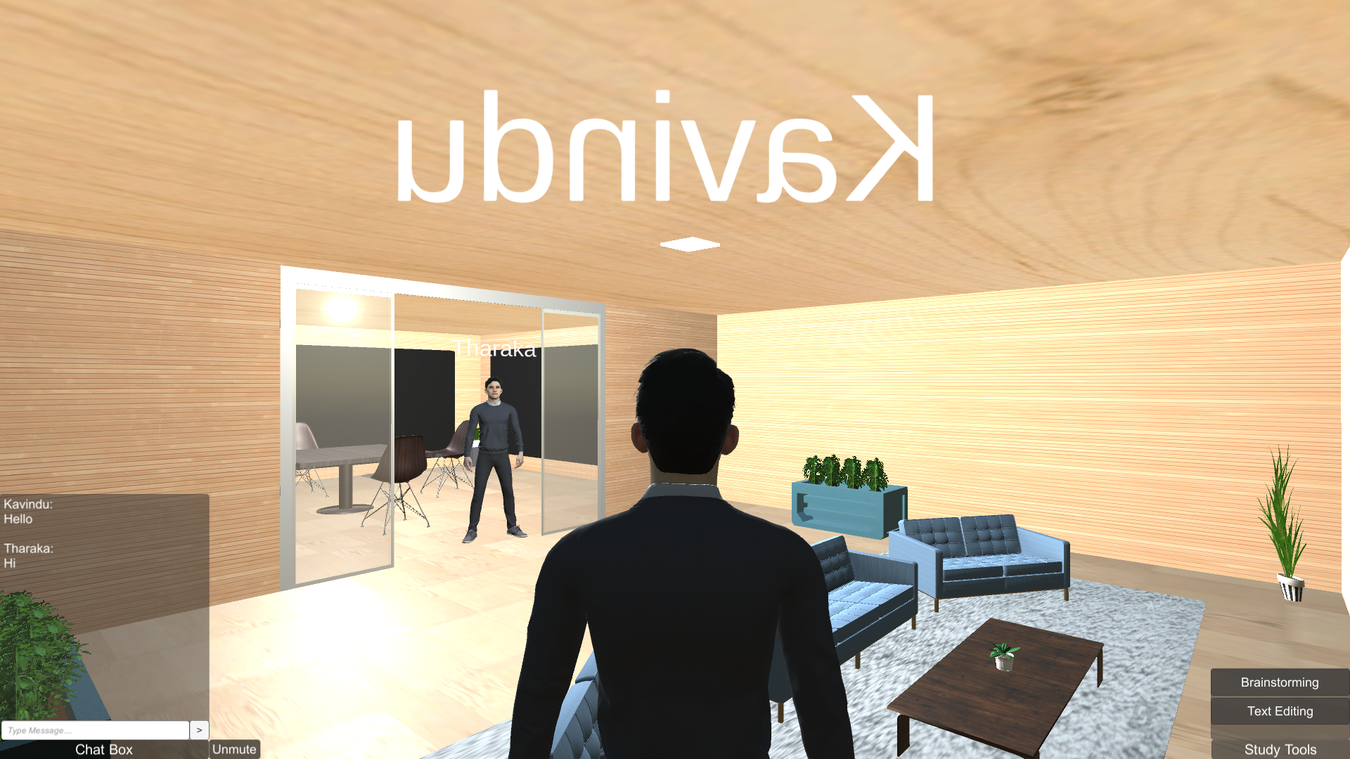
Progress up to Progress Presentation-02 Contd.
IT18001112
Tharaka
W.C.M.K.
34

Slide 41
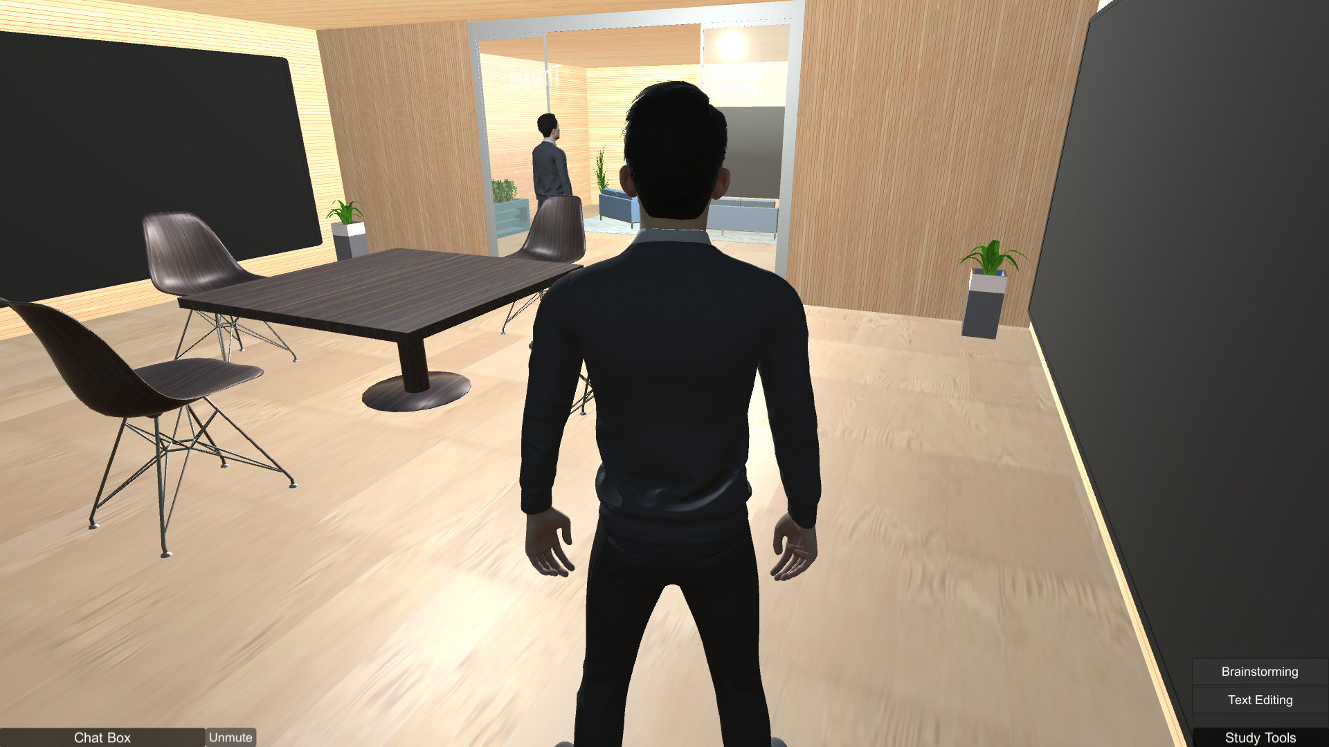
Progress up to Progress Presentation-02 Contd.
IT18001112
Tharaka
W.C.M.K.
35

Slide 42
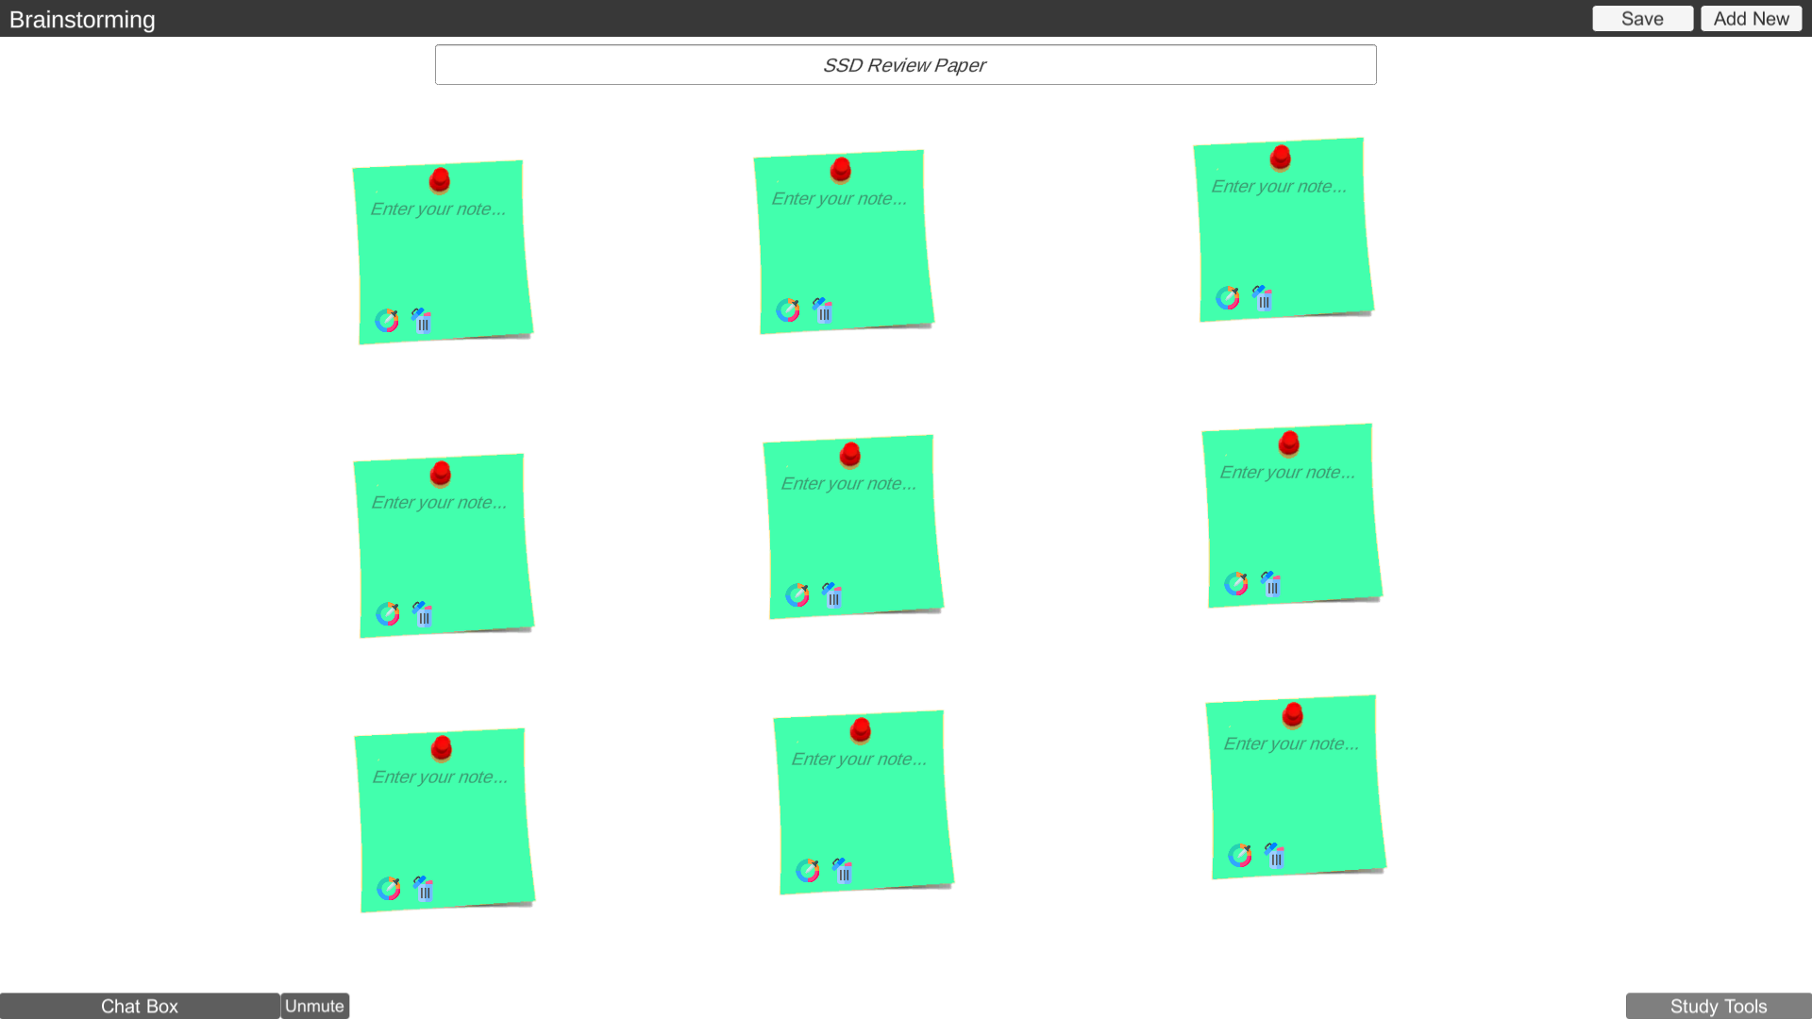
Progress up to Progress Presentation-02 Contd.
IT18001112
Tharaka
W.C.M.K.
36

Slide 43
References
[1] "What are the 4 C's of learning skills?", Newsroom.unl.edu.
[Online]. Available: https://newsroom.unl.edu/announce/csmce/5344/29195 [Accessed: 26 June 2021]
IT18001112
Tharaka
W.C.M.K.
[2] A.Sfard, “On Two Metaphors for Learning and the Dangers of Choosing Just One,”
Educ. Res., vol. 27, no. 2, p. 4, 1998, doi: 10.2307/1176193.
[3] M. Laal and S. M. Ghodsi, "Benefits of collaborative learning," in Procedia -
Social and Behavioral Sciences, Jan. 2012, vol. 31, pp. 486–490, doi: 10.1016/j.sbspro.2011.12.091.
[4] D. Wahyuningsih, “Active Learning Through Discussion in E-Learning,” Int. J. Act. Learn., vol. 1, no. 1, pp. 1–4, 2016, doi: 10.15294/ijal.v1i1.7733.
[5] S. H. Kweon, H. J. Kweon, S. Kim, X. Li, X. Liu, and H. L. Kweon,
“A Brain Wave Research on VR (Virtual Reality) Usage: Comparison Between
VR and 2D Video in EEG Measurement,” in Advances in Intelligent Systems and Computing,
Springer International Publishing, 2017, pp. 194–203. doi: 10.1007/978-3-319-60366-7_19.
37

Slide 44
IT18001112
Tharaka
W.C.M.K.
Demonstration
38

Slide 45
IT18007848
Rathnayake R.H.C.S.
B.Sc. (Hons) Degree in Information Technology Specialization in Software Engineering

Slide 46
SUB OBJECTIVE - 04
Help students by providing well-organized and summarized lecture note using optimized lecture transcription

Slide 47

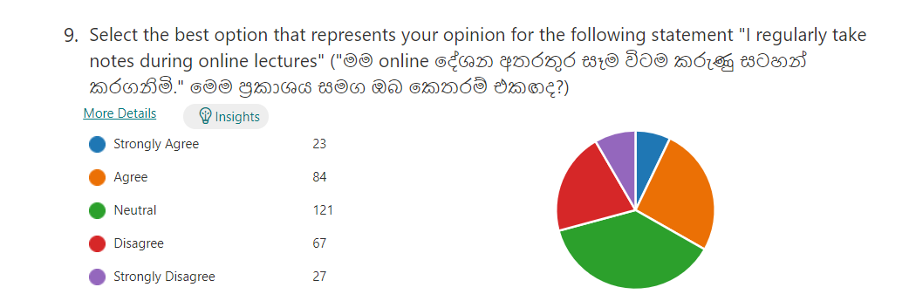
Introduction
IT18007848
Students are tended not to take lecture notes in online lectures
Rathnayake
R.H.C.S
There is no lecture note generation tool currently available in the
The E-learning domain
There is a limited number of researches about lecture summarization
And lecture summarization tools for students
39

Slide 48
Research Question
IT18007848
How to help students with special needs to take an accurate lecture note?
Rathnayake
R.H.C.S
How to provide a well-organized lecture note with summarization
Of the conducted lecture
40

Slide 49
Objectives
IT18007848
Use of speech recognition method to transcribe lecturer demonstration
Rathnayake
R.H.C.S
Train named entity recognition model to identify the important words of the lecture
Demonstration and to extract the important words from the lecture transcription
Organize the optimized lecture transcription with the summarization of the lecture
And make it available to the students.
41

Slide 50
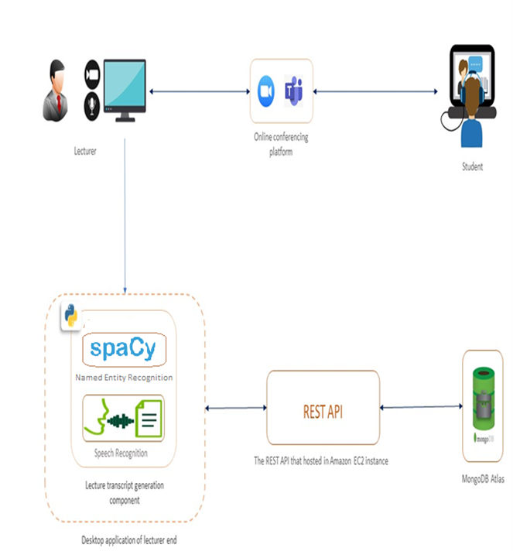
System Diagram for lecturer note generator
IT18007848
Rathnayake
R.H.C.S
Web Speech API for speech recognition
Python
Flask framework
Spacy model and its library for named entity recognition
Google Collab – to gain computation power to train
machine learning model
Mongo DB Atlas – Cloud database
Node.JS, Express.JS – Web server and REST APIs
AWS EC2 cloud service - Cloud Sever
42

Slide 51
Functional & Non-Functional Requirements
IT18007848
Completed Functional Requirements of the Component
Rathnayake
R.H.C.S
Support for real time transcription of lecturer speech into text
Model should be able to communicate through an API
Should be able to detect and extract important words/entities of the lecture demonstration
Should be able to deliver summarized and well-organized lecture note at the end
Non-Functional Requirements of the Component
Availability - Mongo DB cloud, AWS EC2
Usability - Use with different conferencing platforms
Reusability - Reusable model
43

Slide 52
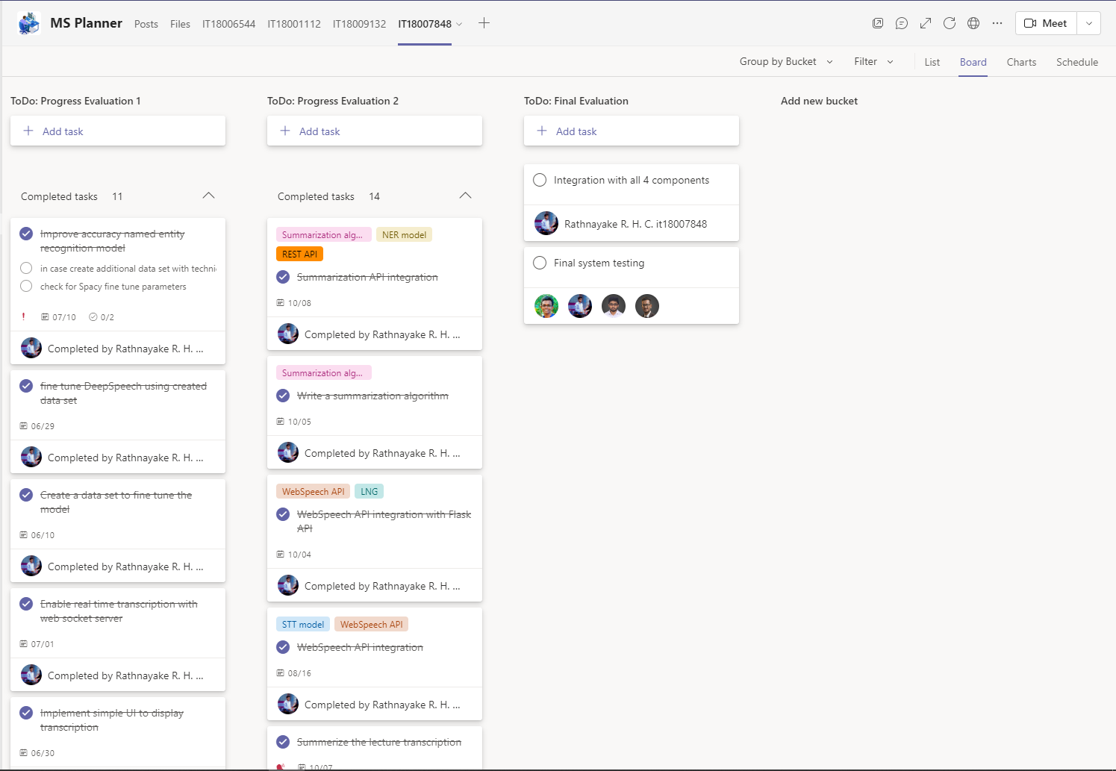
Progress up to Progress Presentation-02
IT18007848
Rathnayake
R.H.C.S
44

Slide 53
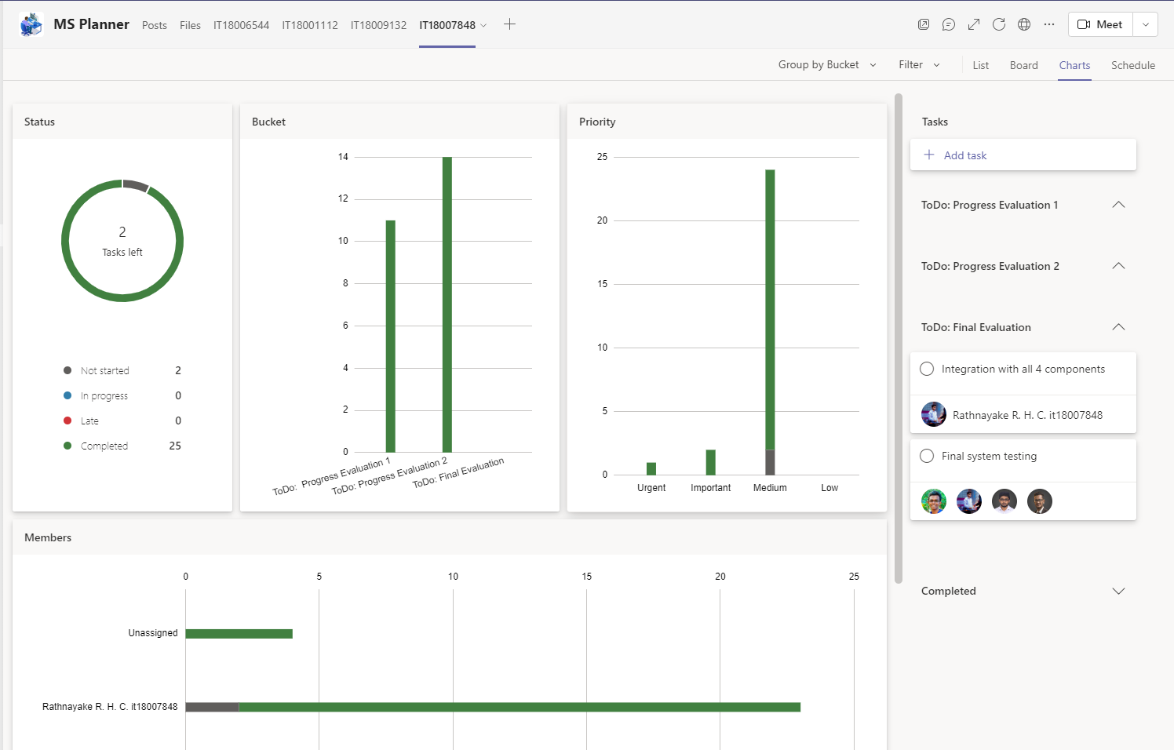
Progress up to Progress Presentation-02 Contd.
IT18007848
Rathnayake
R.H.C.S
45

Slide 54
Progress up to Progress Presentation-02 Contd.
IT18007848
Use of speech recognition method to transcribe the demonstration
Rathnayake
R.H.C.S
Enable real-time transcription
Train named entity recognition model for summarization
Summarization algorithm
API to communicate with model and summarization algorithm
Organize lecture transcription with its summarization
Make accessible lecture notes to the students
46

Slide 55
Raised Problems and Risks
Enable real-time transcription of lecture demonstration
When conferencing tool running - Addressed
IT18007848
Rathnayake
R.H.C.S
Method to summarize the lecture transcript - Addressed
Improve the accuracy of named entity recognition model - Addressed
Algorithm to summarize based on named entities - Addressed
Make available lecture note to the students - Addressed
47

Slide 56
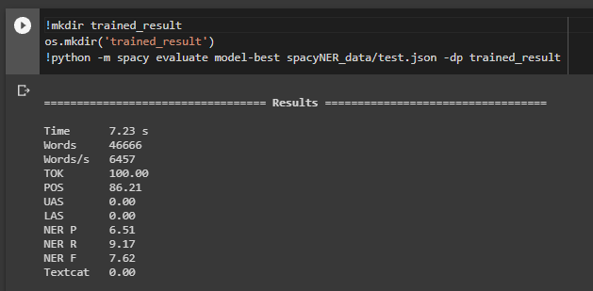
Progress up to Progress Presentation-02 Contd.
IT18007848
Rathnayake
R.H.C.S
Improved accuracy -> 76.2%
Model trained on 46666 of words
- CoNLL 2003 (English) Data set
Tested with 6457 test data
48

Slide 57
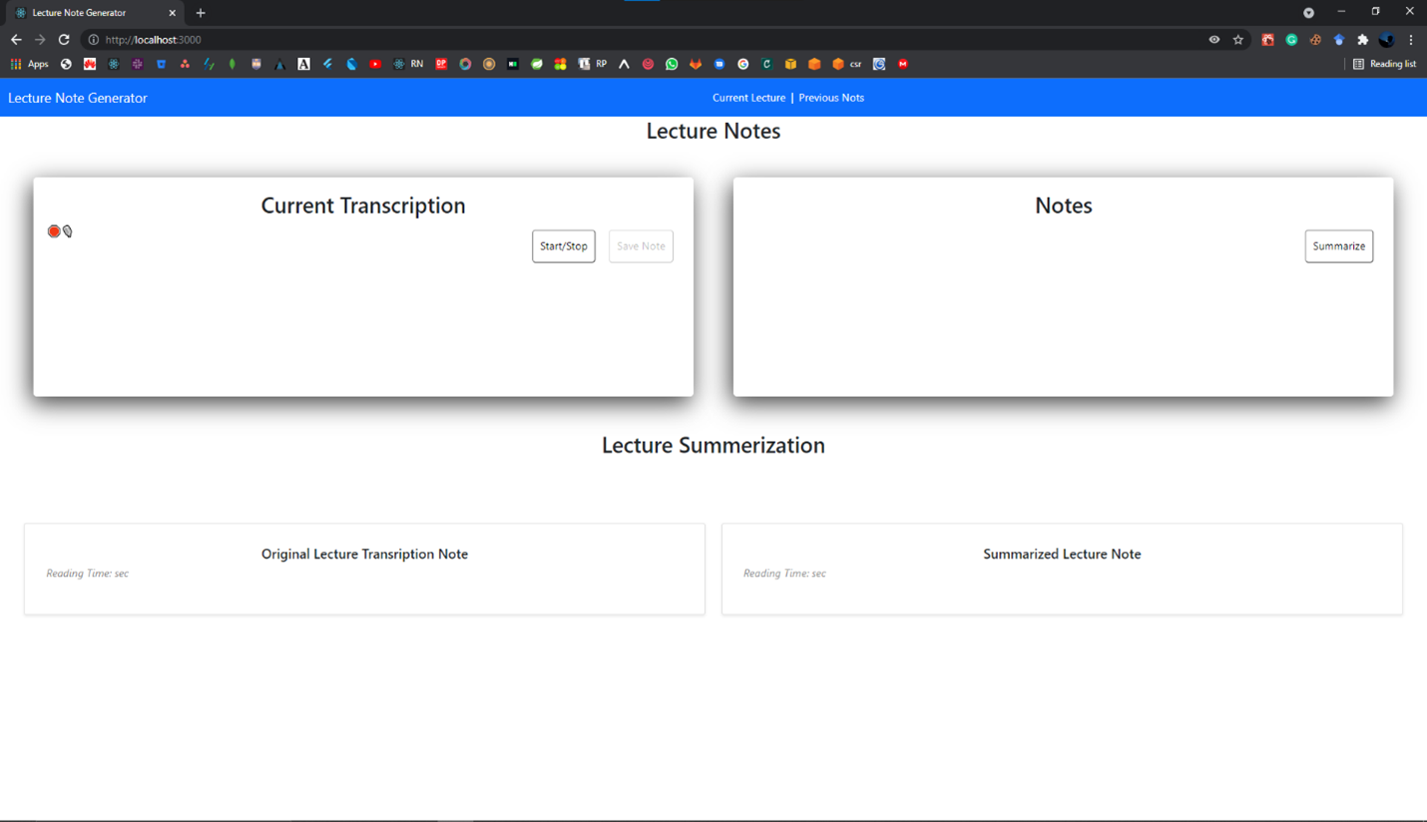
Progress up to Progress Presentation-02 Contd.
IT18007848
Rathnayake
R.H.C.S
49

Slide 58
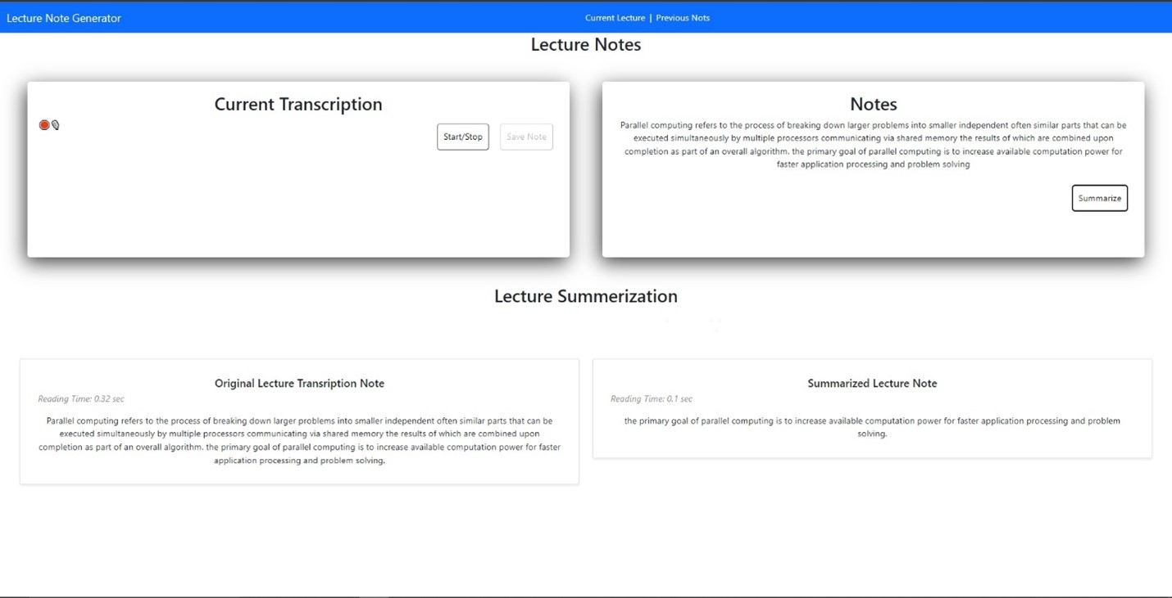
Progress up to Progress Presentation-02 Contd.
IT18007848
Rathnayake
R.H.C.S
50

Slide 59
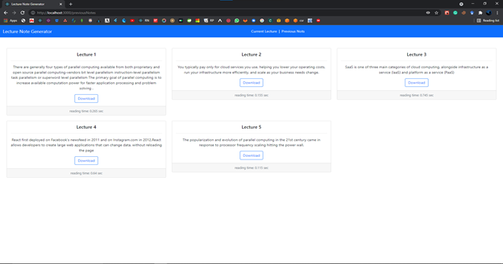
Progress up to Progress Presentation-02 Contd.
IT18007848
Rathnayake
R.H.C.S
51

Slide 60
References
[1] S. Jugran, A. Kumar, B. S. Tyagi, and V. Anand, “Extractive Automatic Text Summarization using SpaCy in Python & NLP,” in 2021 International Conference on Advance Computing and Innovative Technologies in Engineering (ICACITE), 2021, pp. 582–585.
IT18007848
Rathnayake
R.H.C.S
[2]Boyle, Joseph & Forchelli, Gina & Cariss, Kaitlyn. (2015). Note-Taking Interventions to Assist Students With Disabilities in Content Area Classes. Preventing School Failure. 1-10. 10.1080/1045988X.2014.903463.
[3]A. Anandika and S. P. Mishra, “A study on machine learning approaches for named entity recognition,” in 2019 International Conference on Applied Machine Learning (ICAML), 2019, pp. 153–159.
[4]Wald, M. (n.d.). Using Automatic Speech Recognition to Enhance Education for All Students: Turning a Vision into Reality. Proceedings Frontiers in Education 35th Annual Conference. doi:10.1109/fie.2005.1612286
[5]“Training Pipelines & Models · spaCy Usage Documentation,” Spacy.io. [Online]. Available: https://spacy.io/usage/training. [Accessed: 13-Oct-2021].
[6]Data set - https://deepai.org/dataset/conll-2003-english
52

Slide 61
IT18007848
Rathnayake
R.H.C.S
Demonstration
53

Slide 62
IT18009132
Dilanka R.M.T.
B.Sc. (Hons) Degree in Information Technology Specialization in Software Engineering

Slide 63
SUB OBJECTIVE - 03
Providing a near-real time, simulated student behavioral view of the students

Slide 64

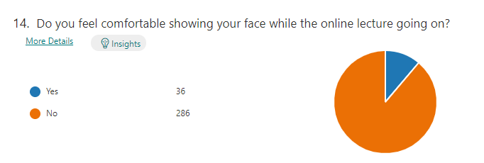
Introduction
IT18009132
students are reluctant to expose their faces and backgrounds to the other attendees during the online lecture
Dilanka R.M.T.
88%
lecturer cannot see the students' live reactions and engagement
Feel less motivation
Maintaining students’ attention is more challenging
54
Observe all the student behaviours in a screen is not practical

Slide 65
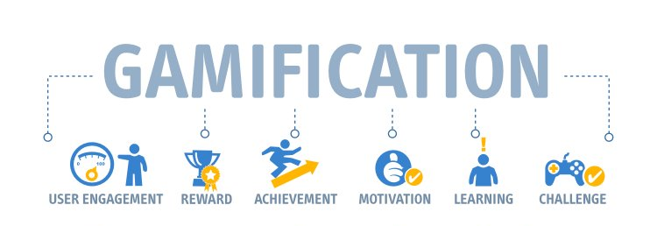
Introduction
IT18009132
Apply Gamification Concepts to online teaching
Dilanka R.M.T.
55

Slide 66
Research Question
IT18009132
How to use Gamification concepts in online teaching
Dilanka R.M.T.
How to create the experience of a real classroom for lecturers
How to enable separate voice channels between group of students
56

Slide 67
Objectives
IT18009132
Providing a near-real time, simulated students' behavioral view to the lecturer
Dilanka R.M.T.
Build the Virtual Class Room Environment
Build Student Representational Models With Facial Expressions and Behaviours
Enable separate voice communication between lecturer and selected student group
57

Slide 68
System, Software and Personnel Requirements
IT18009132
Functional Requirements
Dilanka R.M.T.
Virtual classroom with near real-time student behaviours
Attentiveness of each student and Overall class room status
Lecturer should notify if most students got confused at a point
Student engagement report though out the lecturer
Non-Functional Requirements
Availability
Reusability
Scalability
Useability
58

Slide 69
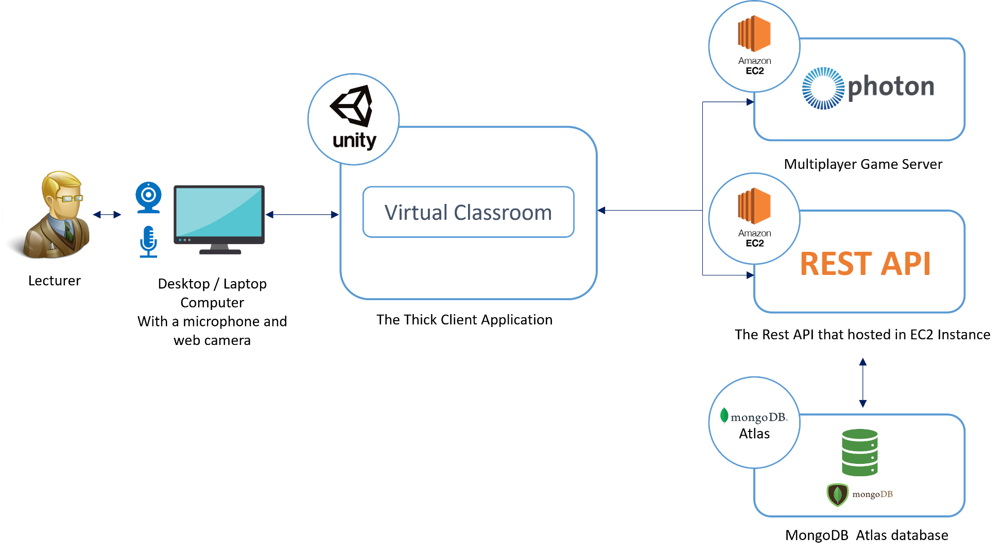
System Overview Diagram
IT18009132
Dilanka R.M.T.
59

Slide 70
Technologies
IT18009132
Unity Game Engine - Build the Virtual Environment
Dilanka R.M.T.
C# - Development language of Unity
Visual Studio IDE
Photon Unity Networking - Multiuser Development in Unity
Agora - Enable voice communication between lecturer and students
Mongo DB Atlas - Database
Node.JS, Express.JS - REST API
AWS EC2 cloud service - Cloud Sever
60

Slide 71
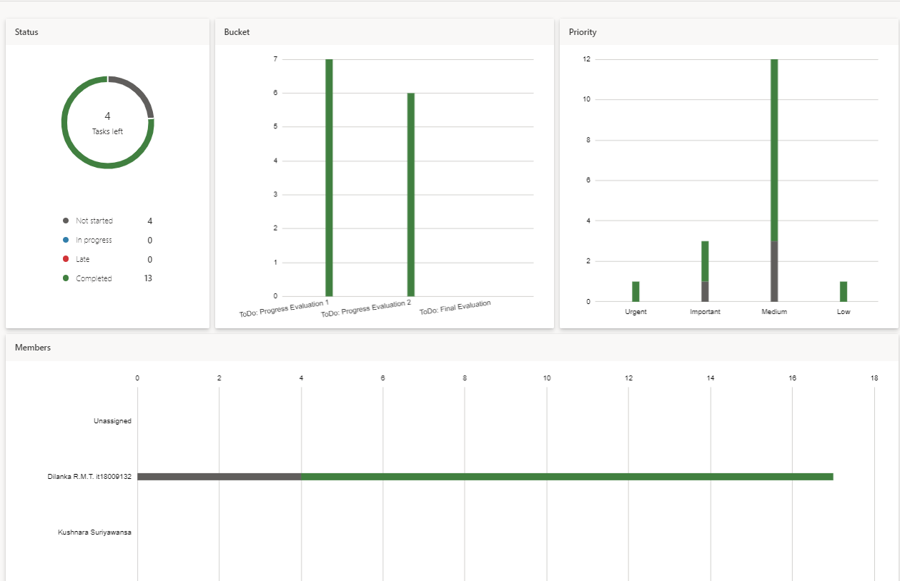
Progress up to Progress Presentation-02
IT18009132
Dilanka R.M.T.
61

Slide 72
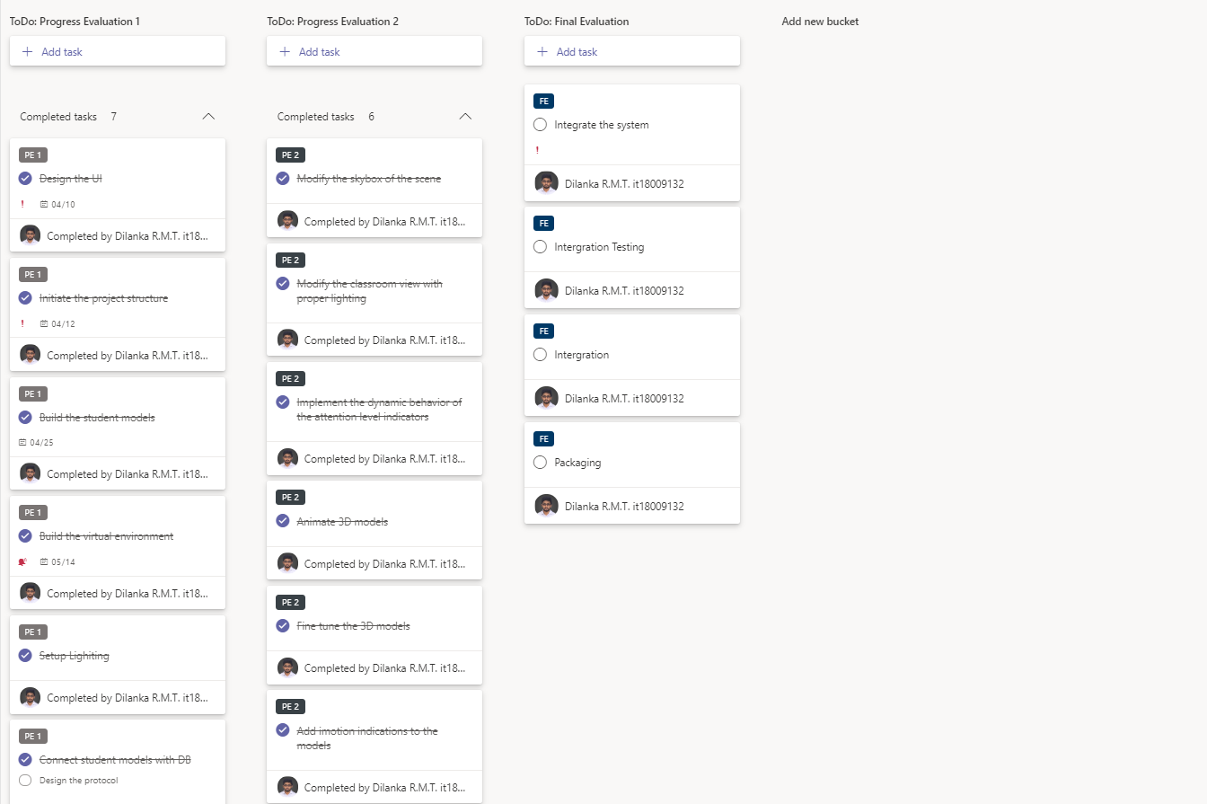
Progress up to Progress Presentation-02 contd.
IT18009132
Dilanka R.M.T.
62

Slide 73

Progress up to Progress Presentation-02 contd.
IT18009132
Completed
Dilanka R.M.T.
UI Design
Create the lecture hall scene
Develop an API-Stub to mock the database connectivity
Create basic student models
Setup lighting and Physical behaviors in the environment
Dynamically Render the student models to the view
Add attention level indicators
Redesign the lecture hall
63

Slide 74
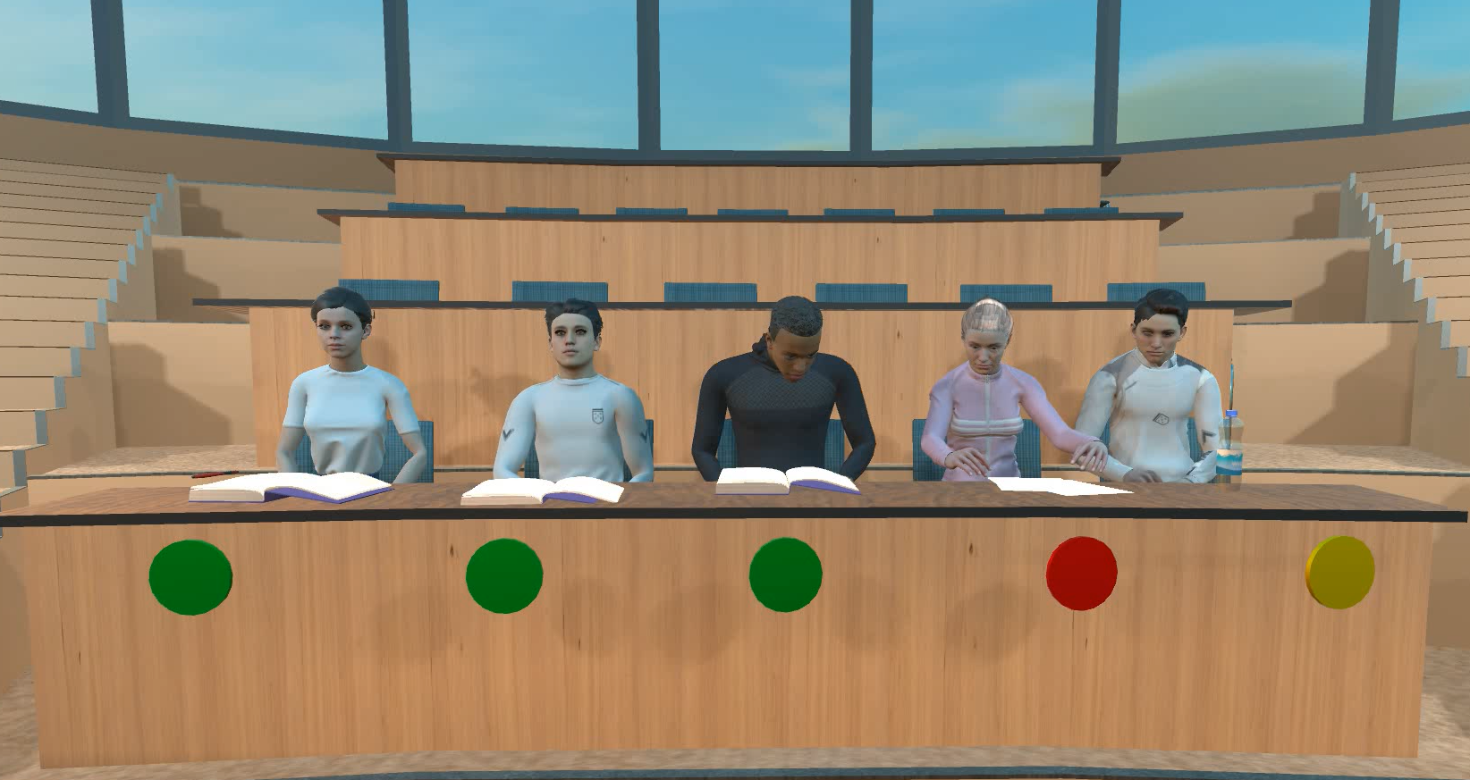
Progress up to Progress Presentation-02 contd.
IT18009132
Dilanka R.M.T.
64

Slide 75
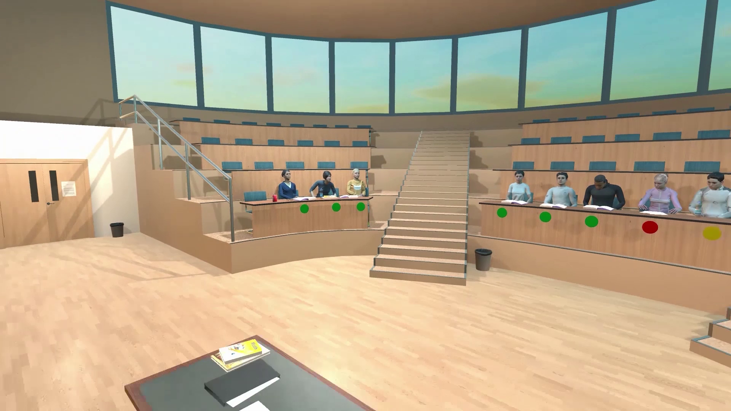
Progress up to Progress Presentation-02 contd.
IT18009132
Dilanka R.M.T.
65

Slide 76
IT18009132
Dilanka R.M.T.
Demonstration
66

Slide 77
References
[1] Titan, Ferdianto, G. G. F. P. Desak and Lena, "A comparative study of teaching styles in online learning environment," 2017 International Conference on Information Management and Technology (ICIMTech), Special Region of Yogyakarta, Indonesia, 2017, pp. 25-30, doi: 10.1109/ICIMTech.2017.8273505.
[2] D. Preuveneers and W. Joosen, "Edge-Based and Privacy-Preserving Multi-Modal Monitoring of Student Engagement in Online Learning Environments," 2019 IEEE International Conference on Edge Computing (EDGE), Milan, Italy, 2019, pp. 18-20, doi: 10.1109/EDGE.2019.00017.
[3] M. Atherton, M. Shah, J. Vazquez, Z. Griffiths, B. Jackson, and C. Burgess, “Using learning analytics to assess student engagement and academic outcomes in open access enabling programmes,” Open Learning: The Journal of Open, Distance and e-Learning, vol. 32, no. 2, pp. 119–136, 2017
[4] W. S. Yue, "Enhancement of Learning Management System (LMS) by serious game engine: Collaborative," 2015 4th International Conference on Interactive Digital Media (ICIDM), Bandung, Indonesia, 2015, pp. 1-5, doi: 10.1109/IDM.2015.7516323.
IT18009132
Dilanka R.M.T.
67

Slide 78
Standards & Best Practices
Coding Conventions - Python, C#, JavaScript
IT18009132
Dilanka R.M.T.
Version Controlling Best Practices
Branching conventions
Maintaining separate branches for different environments – Dev, PreProd, Prod
Commit message conventions
68

Slide 79
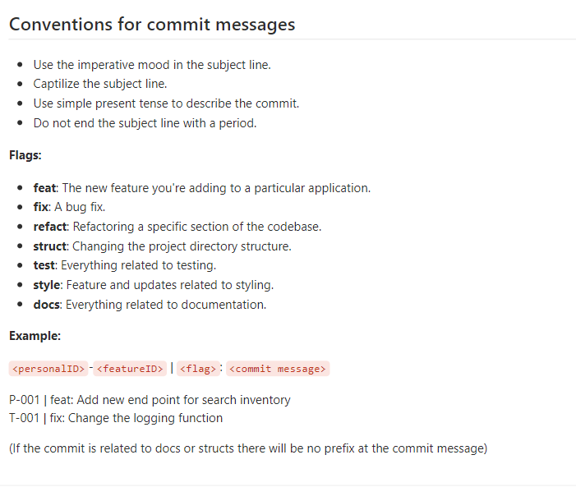
Standards & Best Practices
IT18009132
Dilanka R.M.T.
69

Slide 80
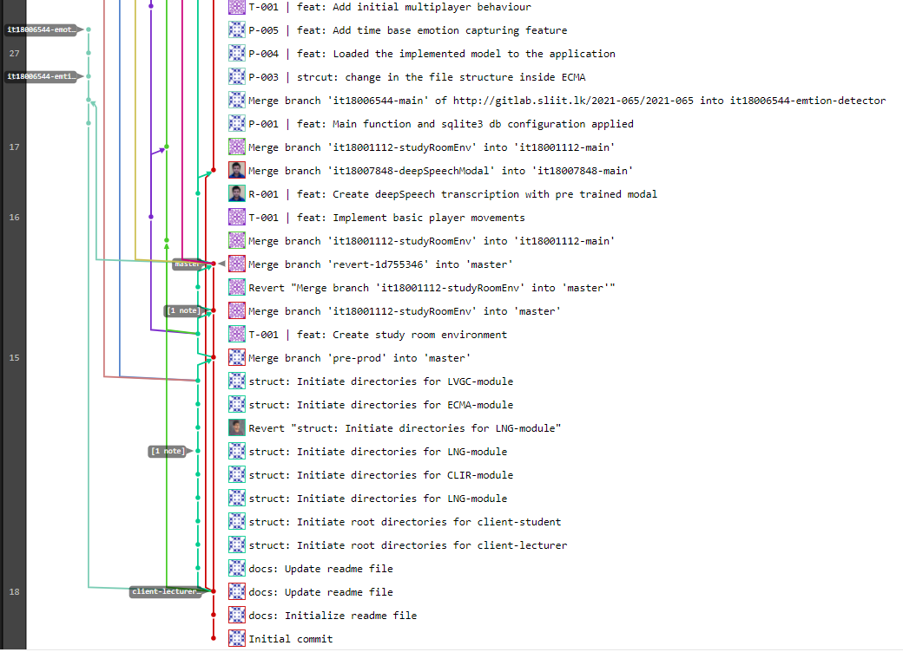
Standards & Best Practices
IT18009132
Dilanka R.M.T.
70

Slide 81
Product Marketing and Commercialization Plan

Slide 82

Marketing Commercialization Plan
Targeted Audience
IT18009132
Dilanka R.M.T.
Educational Institutes
Users: Lecturers and Students
Benefits
Students’ attention can be identified even if the student does not expose their identity to the lecturer
No need of using many tools to do collaborative learning
Students who are doing jobs with education will be able to save their time
Can help students who have hearing and physical impairments
71
Other existing solutions does not provide lecture note feature

Slide 83
Marketing Commercialization Plan
Advertising and Communication
IT18009132
Dilanka R.M.T.
YouTube Channel
Facebook Page
Social Media Advertisements
72

Slide 84
Pricing Strategy
Package 1
Package 2
Package 3
IT18009132
Dilanka R.M.T.
$0/month
$199/month
$399/month
FREE
STANDARD
PREMIUM
Services
Services
Services
Student Attention Level Detection Tool
Virtual Classroom View With Attention Level Indicators
Up to 20 Concurrent Users
Student Attention Level Detection Tool
Virtual Classroom View With Attention Level Indicators
Attention Level Notification
Up to 500 Concurrent Users
Student Attention Level Detection Tool
Virtual Classroom View With Attention Level Indicators
Attention Level Notification
Collaborative Learning Room
Up to 1,000 Concurrent Users
73

Slide 85




Recognition
IT18009132
Dilanka R.M.T.
Finalist
Finalist
73

Slide 86

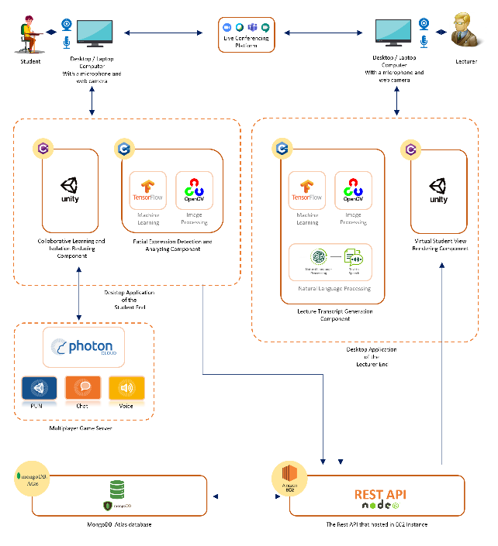
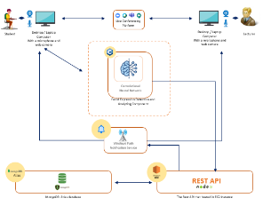
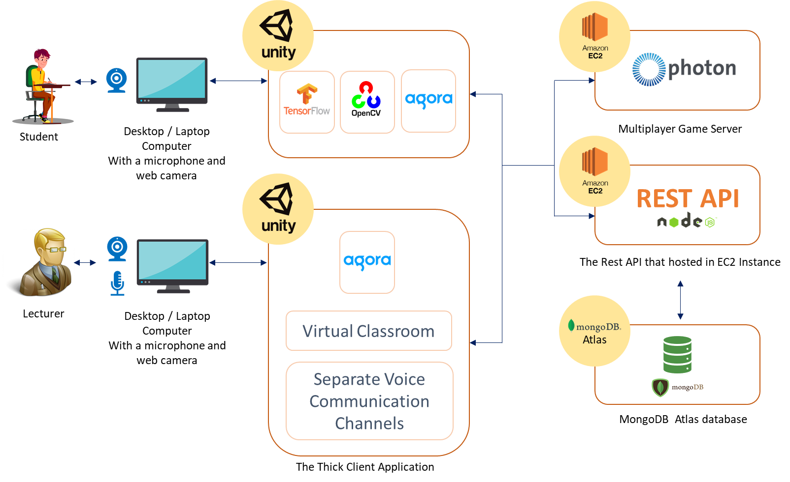
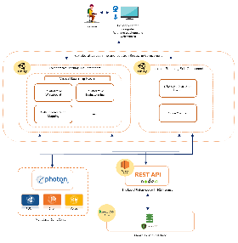
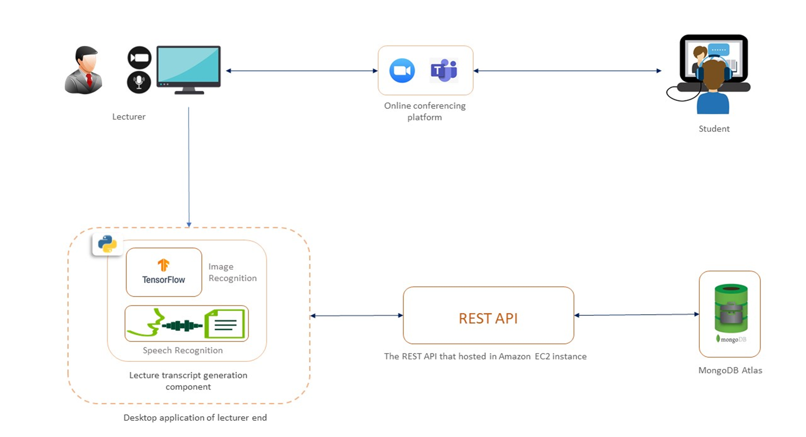
Enhancing Online Teaching and Learning Experience
by using Multiuser Virtual Environment
Background & Literature
Physical lecture delivery not only focuses on lecture material delivery but also on maintaining positive touch between lecturer and students and student to student. Online lectures are gaining popularity as a result of the Covid-19 pandemic situation. The majority of educational institutions have shifted to online delivery through the use of current video conferencing solutions. Due to the fact that video conferencing solutions are not designed for academic purposes, the learning-teaching process has become ineffective. Although humankind is naturally social and favours face-to-face conversation, online delivery is new to the majority of students and instructors. Current off-campus lecture delivery has created a barrier to students’ attentiveness during the lecture and group studying. Also, the lecturer can not see the attentiveness of the students. A multi-user virtual learning environment that addresses the above-mentioned issues is introduced as the developed solution’s primary deliverable. Apart from these problems, the research addresses the students’ isolation during online lectures. Students attend online lectures from the comfort of their own homes and remain alone throughout the presentation. The physical separation of lecturers and students and between students and students causes students to feel isolated during lectures, which can have a detrimental effect on students’ academic development and their social and psychological development. The suggested method would address the mentioned issue by the virtual group study environment.
Research Problem
Due to the fact that video conferencing solutions are not designed for academic purposes, the learning-teaching process has become ineffective. Although humankind is naturally social and favours face-to-face conversation, online delivery is new to the majority of students and instructors. The aim of the research is to find a way to How to enhance online learning and teaching experience.
Solution
As the solution for the mentioned problem, team Escuela has decided to provide a software package that is capable of enhancing online teaching and learning experience. The solution consists of four main modules that need to be incorporated in order to provide a better solution: Attention Detection Module, Collaborative Learning Module, Classroom view Module, Lecture Transcription Generator Module.
Overview Diagram of the Entire System
Objectives
Main Objective: Enhancing Online Teaching and Learning Experience
Sub Objective 1: Analysing the students’ attentiveness to the lecture and help them to keep their attention.
Sub Objective 2: Reducing students' isolation during online lectures and enabling the collaborative learning using multiuser virtual learning environment.
Sub Objective 3: Providing a near-real time, simulated student behavioural view of the students.
Sub Objective 4: Help students by providing well-organized lecture note using optimized lecture transcription and related visual figures of the lecture
Overview Diagram of the Attention Detection Module
Overview Diagram of the Classroom view
Module
Overview Diagram of the Collaborative Learning Module
Overview Diagram of the Lecture Summarization Generator
Module
Results & Discussion
A total of 396 responses were received from university undergraduates and school students.
Among them, 84% of students said they feel bored during online lectures.
89% responded that they do not feel comfortable turning on the web camera and appearing to others in the classroom.
The CNN used to predict the students’ emotions show an accuracy of 60% with 70 epochs.
From user testing, it was identified that students who use the developed platform show better attention towards the lecturer than students who don't.
The concept of lecture note summary may alter educational access for disabled individuals in the future.
This solution allows students to conduct group studies even if they are not physically together
The use of gamification methods has improved student engagement. Less boredom and loneliness among students during lectures.
References
Teras, M., Suoranta, J., Ter ¨ as, H., & Curcher, M. (2020). Post-Covid-19 ¨ Education and Education Technology “Solutionism”: a Seller’s Market. Postdigital Science and Education.
“Global monitoring of school closures caused by COVID-19 pandemic – dashboards – covid-19 response,” Unesco.org. [Online]. Available: http://covid19.uis.unesco.org/global-monitoring-school-closures-covid19/. [Accessed: 19-Aug-2021].
I. A. and A. F., “COVID-19 and E-learning: Nigeria tertiary education system experience,” Rsisinternational.org. [Online]. Available: https://www.rsisinternational.org/journals/ijrias/DigitalLibrary/Vol.5&Issue5/28-31.pdf. [Accessed: 11-Oct-2021]
Methodology
A survey was circulated among the school students and undergraduate to gather information about online education.
Provide a facility to analyse the students’ attentiveness to the lecture and help them to keep their attention.
Reduce the students' isolation during online lectures and enabling the collaborative learning using multiuser virtual learning environment.
Providing a near-real time, simulated student behavioural view of the students.
Providing well-organized and summarized lecture note using optimized lecture transcription

Slide 87

THANK YOU!

